Slide 1
Sweena’s Capstone Project - Car accident severity
IBM DATA SCIENCE COURSE

Slide 2
Helping to reduce the number of accidents.
You’ll be able to reduce the number of accidents by creating bar charts and comparing each data points. For example, you’ll be able to compare the number of accidents that are happening in the daylight and night time and find a way to prevent this.
You will need to also implement systems such as more signs if there is an increase of accidents at interjunctions in order to help drivers prepare or slow down for potential threats.
Bar charts help you compare the number of accidents that happen in various conditions.

Slide 3
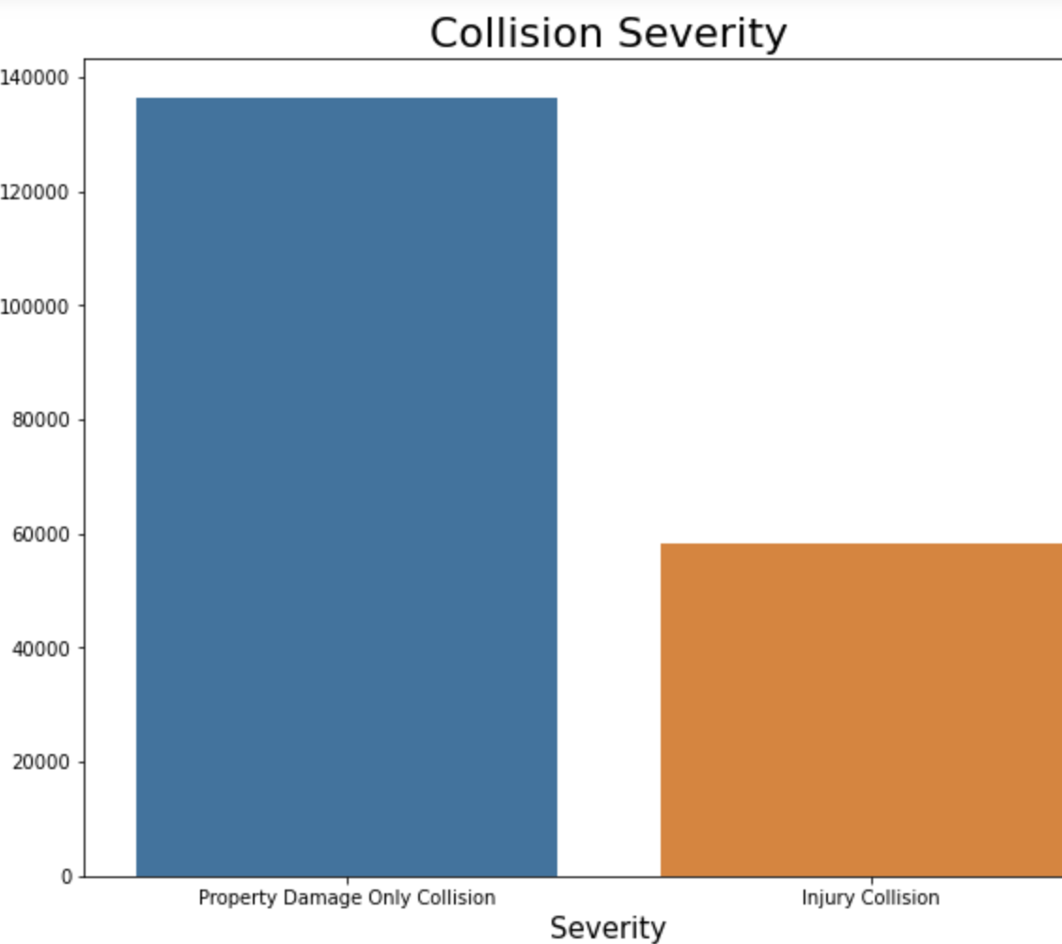
Number of Collisions and The Type of Collision
#Conclusion by looking at this graph
#You are able to see the difference between the injuries and the property and are able to see that the property damages
#are much higher wich means that the accidents may not be as severe as those that are propety

Slide 4
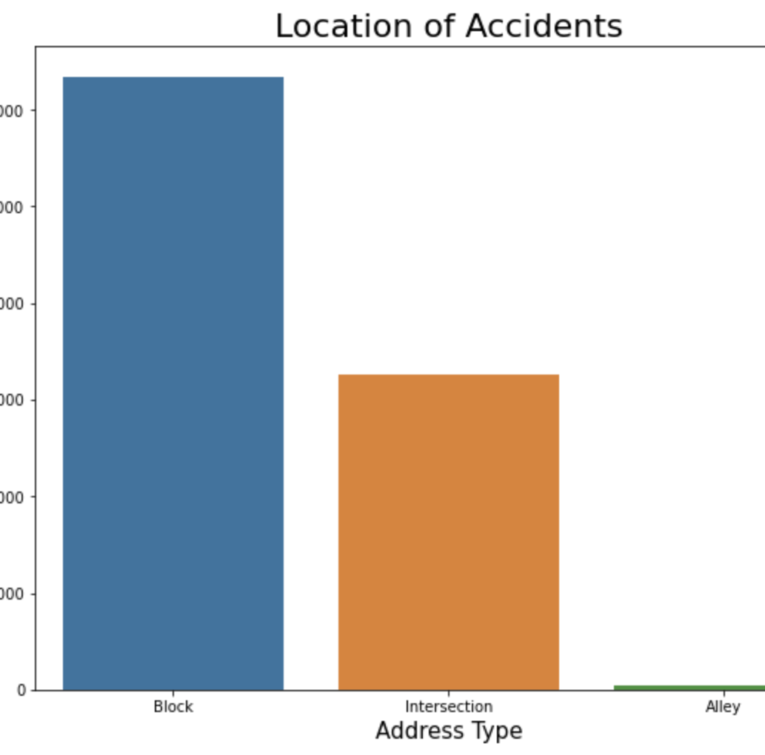
By looking at this graph, you are able to see that the number of accidents at blocks are much higher than intersection. This means that more signs or cameras could be implemented so that you could keep an eye out and also so that individuals would be more aware that this is an area where accidents are likely to occur.
Area of Accident & Number

Slide 5
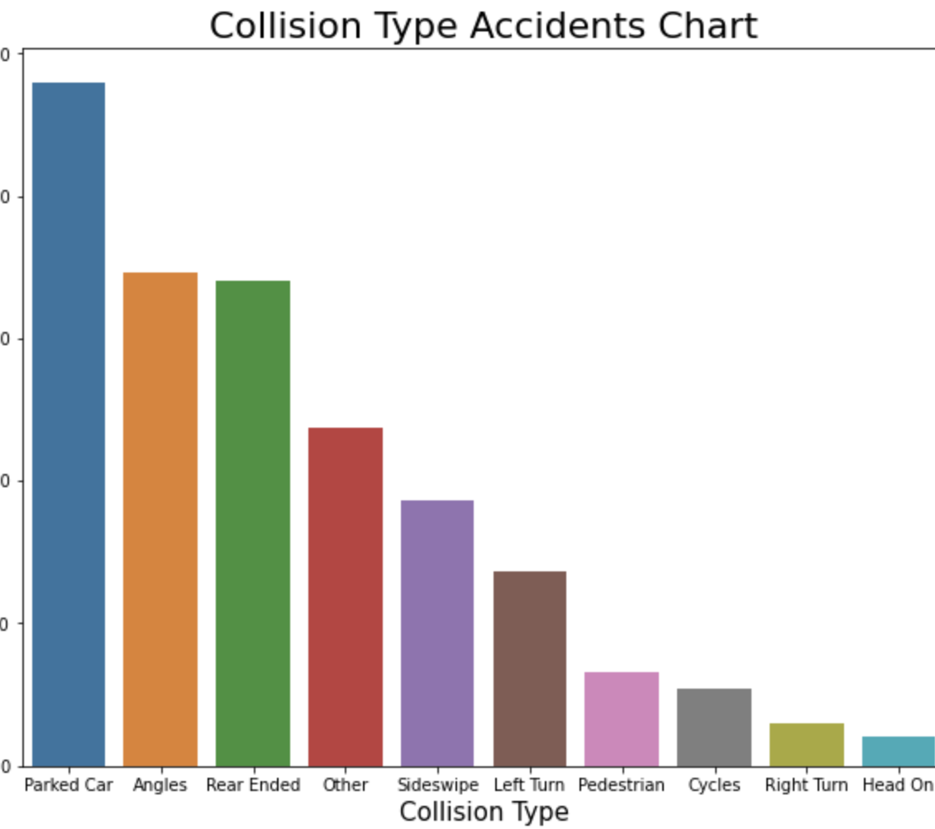
#Here you are able to see that accidents happen a lot more when cars are parked, in order to prevent this you may need
#to implement a parking system that may not be as clsuterred and have a bigger amount of space.

Slide 6
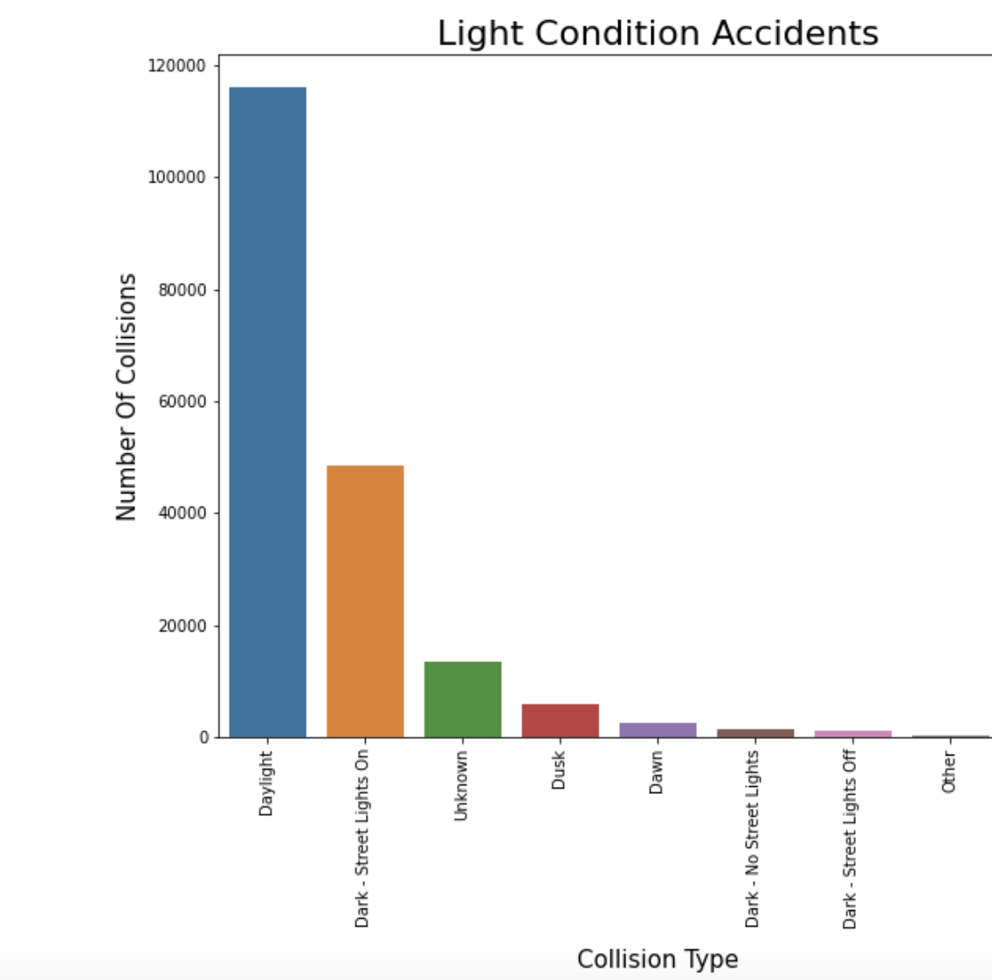
Light Condition of Accident
By looking at this graph, you are able to see that a lot of accidents happen during the daylight. In order to prevent this, you need to ensure that more speed limits are being implements and perhaps more road signs so that drivers could be more aware of what could happen and they could drive more safely. The fact that the number of accidents decrease significantly when it is dark shows that drivers are driving more carefully due to the lack of visibility.

Slide 7
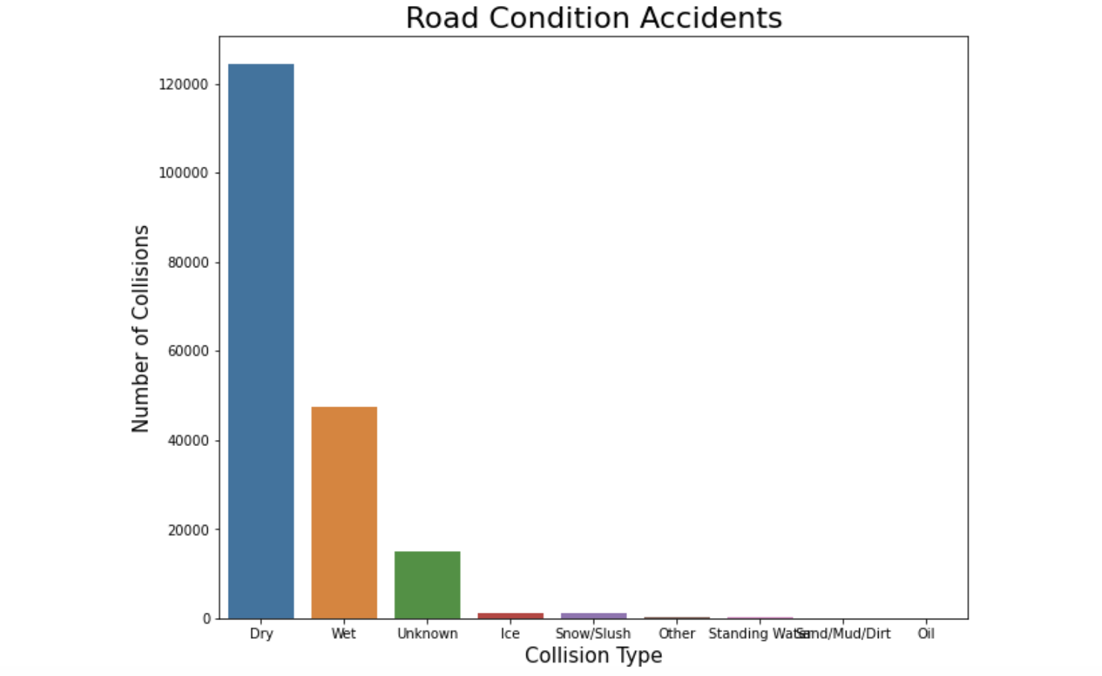
Road Condition Accidents Chart
The fact that the highest number of accidents happen when the conditions of the road are dry links back to the fact that in conditions where drivers are more comfortable, they drive more recklessly which is also evident when you look at the data of the light condition in which accidents happen.

Slide 8
Conclusion
By looking at the data, we can conclude as mentioned previously that the number of accidents increase when drivers are in comfortable environments such as day light or wet conditions. In order to ensure that the number of accidents decrease, a point system could be implemented, if you get into an accident in these conditions, a point will be deducted from the license. If all points are deducted, then the driver has to take another test in order for them to be considered safe to be back on the roads.

